Slide 1


SRM
INSTITUTE OF SCIENCE AND TECHNOLOGY,
CHENNAI.
Department of Computer Science and Engineering
18CSS101J – Programming for Problem Solving Unit I

Slide 2

SRM
INSTITUTE OF SCIENCE AND TECHNOLOGY,
CHENNAI.
COURSE LEARNING RATIONALE (CLR) |  | The purpose of learning this course is to:
CLR -1: | Think and evolve a logically to construct an algorithm into a flowchart and a pseudocode that can be programmed
CLR -2: | Utilize the logical operators and expressions to solve problems in engineering and real-time
CLR -3: | Store and retrieve data in a single and multidimensional array
CLR -4: | Utilize custom designed functions that can be used to perform tasks and can be repeatedly used in any application
CLR -5: | Create storage constructs using structure and unions. Create and Utilize files to store and retrieve information
CLR -6: | Create a logical mindset to solve various engineering applications using programming constructs in C

Slide 3
SRM
INSTITUTE OF SCIENCE AND TECHNOLOGY,
CHENNAI.
COURSE LEARNING OUTCOMES (CLO) |  | At the end of this course, learners will be able to:
CLO -1: | Identify methods to solve a problem through computer programming. List the basic data types and variables in C
CLO -2: | Apply the logic operators and expressions. Use loop constructs and recursion. Use array to store and retrieve data
CLO -3: | Analyze programs that need storage and form single and multi-dimensional arrays. Use preprocessor constructs in C
CLO -4: | Create user defined functions for mathematical and other logical operations. Use pointer to address memory and data
CLO -5: | Create structures and unions to represent data constructs. Use files to store and retrieve data
CLO -6: | Apply programming concepts to solve problems. Learn about how C programming can be effectively used for solutions

Slide 4
SRM
INSTITUTE OF SCIENCE AND TECHNOLOGY,
CHENNAI.
LEARNING RESOURCES
S. No | TEXT BOOKS
1. | Zed A Shaw, Learn C the HardWay: Practical Exercises on the Computational SubjectsYou Keep Avoiding (Like C), AddisonWesley, 2015
2. | W. Kernighan, Dennis M. Ritchie,The C Programming Language, 2nd ed. Prentice Hall, 1996
3. | Bharat Kinariwala,Tep Dobry, Programming in C, eBook
4. | http://www.c4learn.com/learn-c-programming-language/

Slide 5
SRM
INSTITUTE OF SCIENCE AND TECHNOLOGY,
CHENNAI.
UNIT I INTRODUCTION
Evolution of Programming & Languages - Problem Solving through Programming - Creating Algorithms - Drawing Flowcharts - Writing Pseudocode - Evolution of C language, its usage history - Input and output functions: Printf and scanf - Variables and identifiers – Expressions - Single line and multiline comments - Constants, Keywords - Values, Names, Scope, Binding, Storage Classes - Numeric Data types: integer -

Slide 6
SRM
INSTITUTE OF SCIENCE AND TECHNOLOGY,
CHENNAI.
UNIT I INTRODUCTION
floating point - Non-Numeric Data types: char and string - Increment and decrement operator - Comma, Arrow and Assignment operator - Bitwise and Sizeof operator

Slide 7
SRM
INSTITUTE OF SCIENCE AND TECHNOLOGY,
CHENNAI.
1. 1 Evolution of Programming & Languages
A Computer needs to be given instructions in a programming
language that it understands
Programming Language
Artificial language that controls the behavior of computer
Defined through the use of syntactic and semantic rules
Used to facilitate communication about the task of organizing
and manipulating information
Used to express algorithms precisely

Slide 8
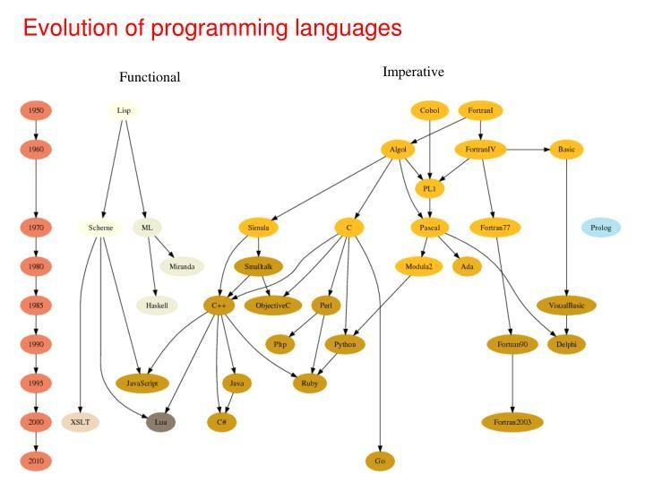

Slide 9
SRM
INSTITUTE OF SCIENCE AND TECHNOLOGY,
CHENNAI.
1. 1 Evolution of Programming & Languages Contd…
Period | Programming Langugaes
1950’s | Creation of high-level languages
1960’s | Forth. Simula I. Lisp, Cobol
1970’s | Pascal, C language
1980’s | ML. Smalltalk, C++
1990’s | Java, Perl, Python languages
2000 | Internet Programming
2010 | Concurrency and asynchronicity. JavaScript and Go language

Slide 10
SRM
INSTITUTE OF SCIENCE AND TECHNOLOGY,
CHENNAI.
1. 2 Problem Solving through Programming
Problem - Defined as any question, something involving doubt, uncertainty, difficulty, situation whose solution is not immediately obvious
Computer Problem Solving
Understand and apply logic
Success in solving any problem is only possible after we have
made the effort to understand the problem at hand
Extract from the problem statement a set of precisely defined tasks

Slide 11
SRM
INSTITUTE OF SCIENCE AND TECHNOLOGY,
CHENNAI.
1. 2 Problem Solving through Programming Contd…
Creative Thinking
Proven method for approaching a challenge or opportunity in an imaginative way
Process for innovation that helps explore and reframe the problems faced, come up with new, innovative responses and solutions and then take action
It is generative, nonjudgmental and expansive
Thinking creatively, a lists of new ideas are generated

Slide 12
SRM
INSTITUTE OF SCIENCE AND TECHNOLOGY,
CHENNAI.
1. 2 Problem Solving through Programming Contd…
Critical Thinking
Engages a diverse range of intellectual skills and activities that are concerned with evaluating information, our assumptions and our thinking processes in a disciplined way so that we can think and assess information more comprehensively
It is Analytical, Judgmental and Selective
Thinking critically allows a programmer in making choices

Slide 13
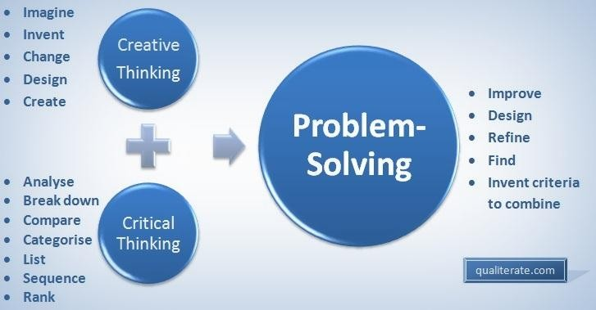
SRM
INSTITUTE OF SCIENCE AND TECHNOLOGY,
CHENNAI.
1. 2 Problem Solving through Programming Contd…

Slide 14
SRM
INSTITUTE OF SCIENCE AND TECHNOLOGY,
CHENNAI.
1. 2 Problem Solving through Programming Contd…
Program - Set of instructions that instructs the computer to do
a task
Programming Process
Defining the Problem
Planning the Solution
Coding the Program
Testing the Program
Documenting the Program

Slide 15
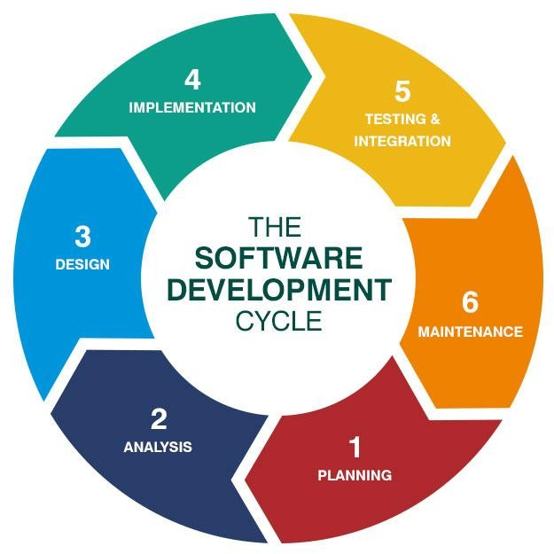
SRM
INSTITUTE OF SCIENCE AND TECHNOLOGY,
CHENNAI.
1. 2 Problem Solving through Programming Contd…

Slide 16
SRM
INSTITUTE OF SCIENCE AND TECHNOLOGY,
CHENNAI.
1. 2 Problem Solving through Programming Contd…
A typical programming task can be divided into two phases:
Problem solving phase
Produce an ordered sequence of steps that describe solution
of problem this sequence of steps is called an Algorithm
Implementation phase
Implement the program in some programming language
Steps in Problem Solving
Produce a general algorithm (one can use pseudocode)

Slide 17
SRM
INSTITUTE OF SCIENCE AND TECHNOLOGY,
CHENNAI.
2 Problem Solving through Programming Contd…
Refine the algorithm successively to get step by step detailed
algorithm that is very close to a computer language
Pseudocode is an artificial and informal language that helps
programmers develop algorithms
Pseudocode is very similar to everyday English

Slide 18

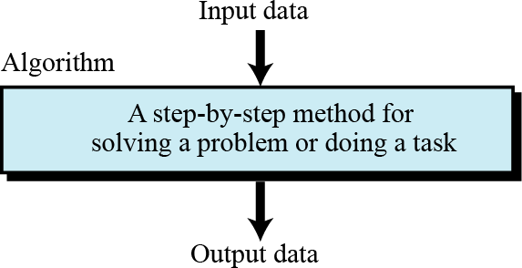
SRM
INSTITUTE OF SCIENCE AND TECHNOLOGY,
CHENNAI.
1. 3 Creating Algorithms
An informal definition of an algorithm is:
i
Algorithm: a step-by-step method for solving a problem or doing a task.

Slide 19
SRM
INSTITUTE OF SCIENCE AND TECHNOLOGY,
CHENNAI.
1. 3 Creating Algorithms Contd…
What are Algorithms for?
A way to communicate about your problem/solution with others
A possible way to solve a given problem
A "formalization" of a method, that will be proved
A mandatory first step before implementing a solution
Algorithm Definition - “A finite sequence of unambiguous, executable steps or instructions, which, if followed would ultimately terminate and give the solution of the problem”

Slide 20
SRM
INSTITUTE OF SCIENCE AND TECHNOLOGY,
CHENNAI.
1. 3 Creating Algorithms
Notations
Starting point
Step Numbers – Positions in Algorithm
Incoming Information - Input
Control Flow – Order of evaluating Instructions
Statements
Outgoing Information - Output
Ending Point

Slide 21
SRM
INSTITUTE OF SCIENCE AND TECHNOLOGY,
CHENNAI.
1. 3 Creating Algorithms Contd…
Properties of an algorithm
Finite: The algorithm must eventually terminate
Complete: Always give a solution when one exists
Correct (sound): Always give a correct solution
Rules of Writing an Algorithm
Be consistent
Have well Defined input and output
Do not use any syntax of any specific programming language

Slide 22
SRM
INSTITUTE OF SCIENCE AND TECHNOLOGY,
CHENNAI.
1. 3 Creating Algorithms Contd…
Algorithm development process consists of five major steps
Step 1: Obtain a description of the problem
Step 2: Analyze the problem
Step 3: Develop a high-level algorithm
Step 4: Refine the algorithm by adding more detail
Step 5: Review the algorithm

Slide 23
SRM
INSTITUTE OF SCIENCE AND TECHNOLOGY,
CHENNAI.
1. 3 Creating Algorithms Contd…
Example
Problem
Develop an algorithm for finding the largest integer among a list of positive integers
The algorithm should find the largest integer among a list of any values
The algorithm should be general and not depend on the number of integers

Slide 24
SRM
INSTITUTE OF SCIENCE AND TECHNOLOGY,
CHENNAI.
1. 3 Creating Algorithms Contd…
Solution
To solve this problem, we need an intuitive approach
First use a small number of integers (for example, five), then extend the solution to any number of integers
The algorithm receives a list of five integers as input and gives the largest integer as output

Slide 25
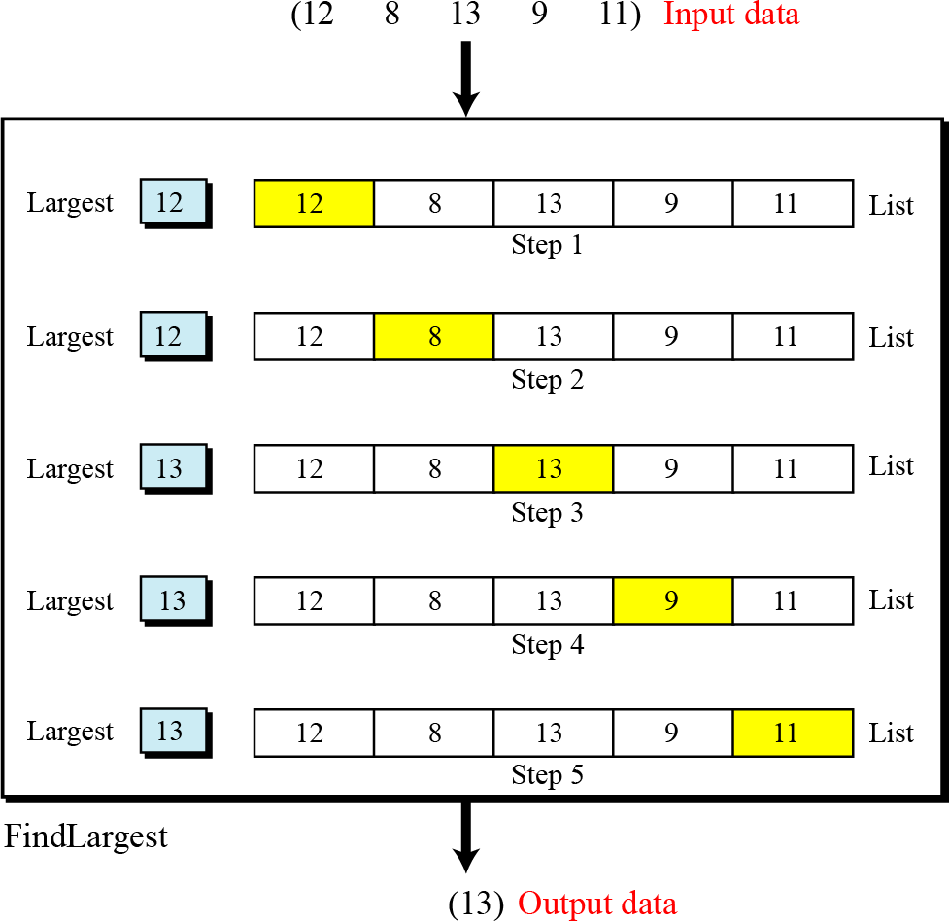
SRM
INSTITUTE OF SCIENCE AND TECHNOLOGY,
CHENNAI.

Slide 26
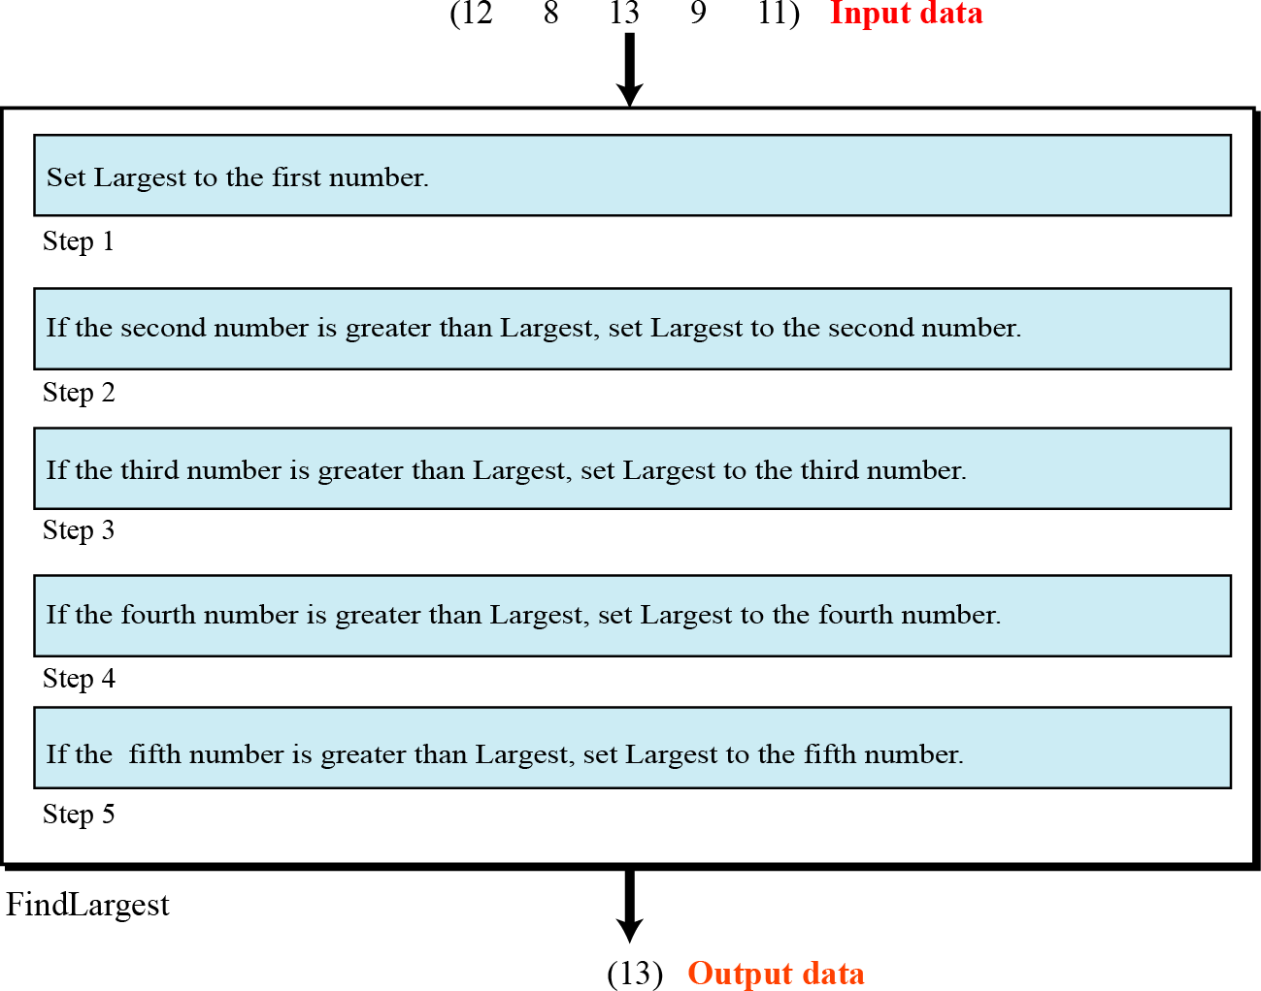
SRM
INSTITUTE OF SCIENCE AND TECHNOLOGY,
CHENNAI.

Slide 27
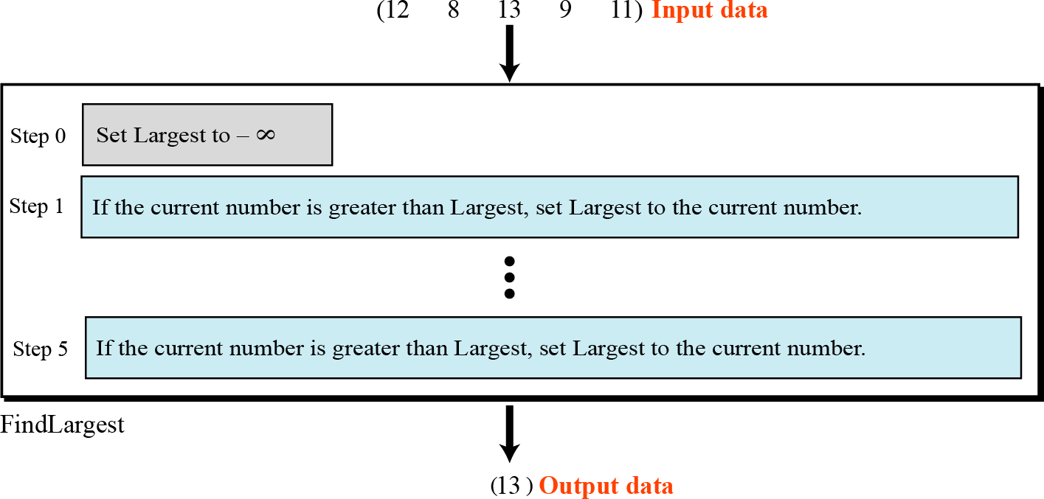
SRM
INSTITUTE OF SCIENCE AND TECHNOLOGY,
CHENNAI.

Slide 28
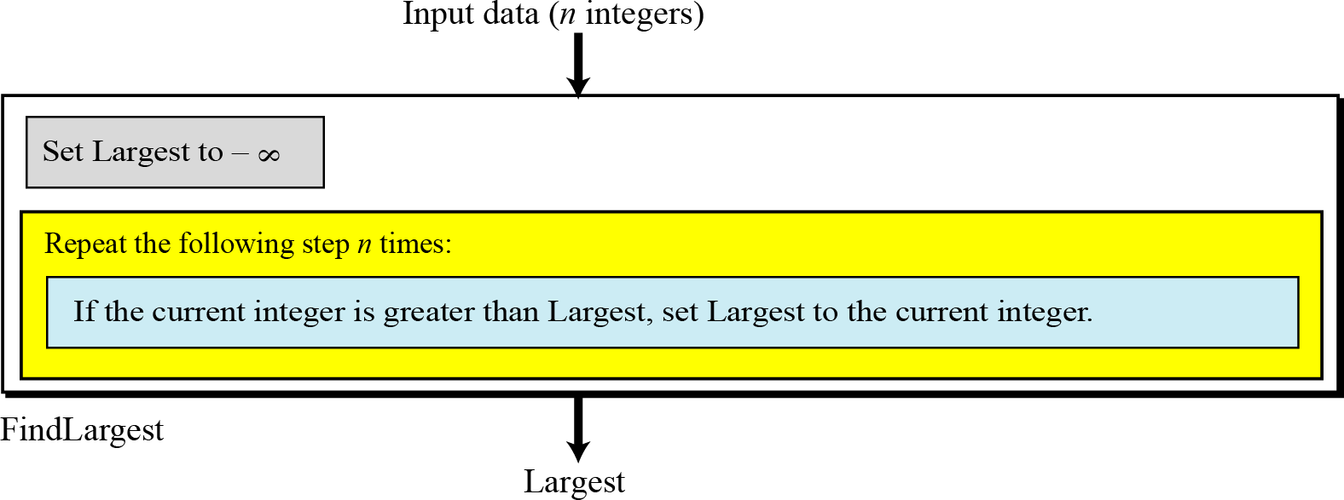
SRM
INSTITUTE OF SCIENCE AND TECHNOLOGY,
CHENNAI.

Slide 29
SRM
INSTITUTE OF SCIENCE AND TECHNOLOGY,
CHENNAI.
3 Creating Algorithms Contd…
Example 2: Print 1 to 20
Step 1: Start
Step 2: Initialize X as 0,
Step 3: Increment X by 1,
Step 4: Print X,
Step 5: If X is less than 20 then go back to step 2.
Step 6: Stop

Slide 30
SRM
INSTITUTE OF SCIENCE AND TECHNOLOGY,
CHENNAI.
3 Creating Algorithms Contd…
Example 3
Convert Temperature from Fahrenheit (℉) to Celsius (℃)
Step 1: Start
Step 2: Read temperature in Fahrenheit
Step 3: Calculate temperature with formula C=5/9*(F-32)
Step 4: Print C
Step 5: Stop

Slide 31
SRM
INSTITUTE OF SCIENCE AND TECHNOLOGY,
CHENNAI.
3 Creating Algorithms Contd…
Example 4
Algorithm to Add Two Numbers Entered by User
Step 1: Start
Step2: Declare variables num1, num2 and sum.
Step 3: Read values num1 and num2.
Step 4: Add num1 and num2 and assign the result to sum. sum←num1+num2
Step 5: Display sum Step 6: Stop

Slide 32
SRM
INSTITUTE OF SCIENCE AND TECHNOLOGY,
CHENNAI.
1. 3 Creating Algorithms Contd…
Write an Algorithm to:
Find the Largest among three different numbers
Find the roots of a Quadratic Equation
Find the Factorial of a Number
Check whether a number entered is Prime or not
Find the Fibonacci Series

Slide 33
SRM
INSTITUTE OF SCIENCE AND TECHNOLOGY,
CHENNAI.
1. 3 Drawing Flowcharts
Diagrammatic representation
Illustrates sequence of operations to be performed
Each step represented by a different symbol
Each Symbol contains short description of the Process
Symbols linked together by arrows
Easy to understand diagrams
Clear Documentation
Helps clarify the understanding of the process

Slide 34
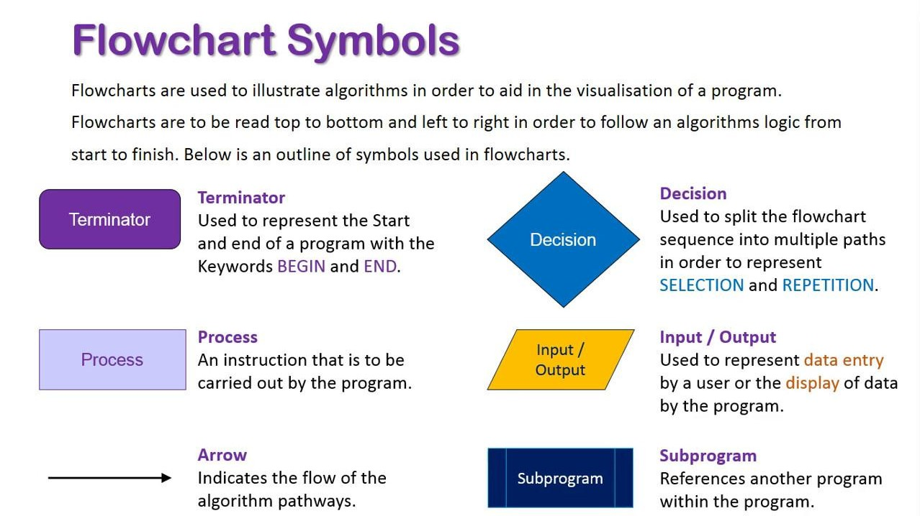

Slide 35
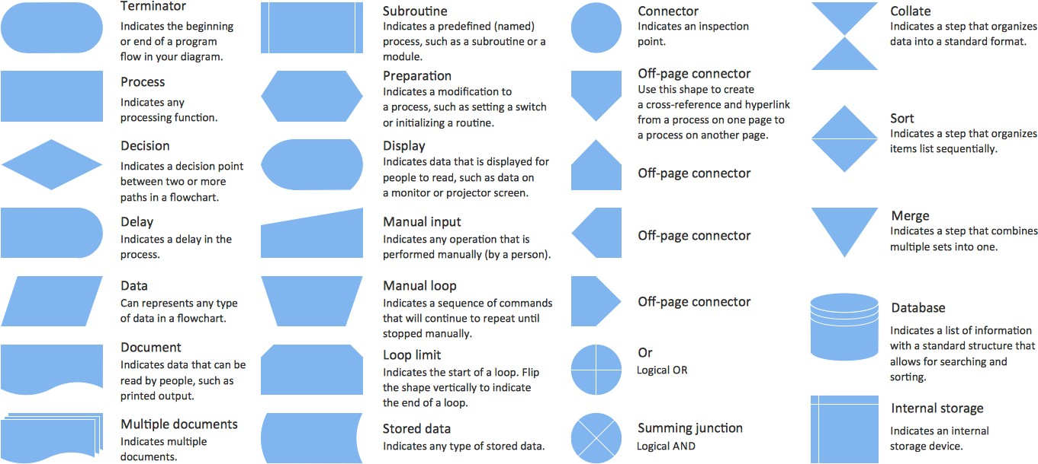
SRM
INSTITUTE OF SCIENCE AND TECHNOLOGY,
CHENNAI.
1. 3 Drawing Flowcharts Contd…

Slide 36
SRM
INSTITUTE OF SCIENCE AND TECHNOLOGY,
CHENNAI.
1. 3 Drawing Flowcharts Contd…
Guidelines for Preparing Flowchart
Logical order of requirements
Ensure that Flowchart has logical Start and Stop
Direction is from Top to bottom
Only one flow line is used with Terminal Symbol
Only one flow line should come out of a Process symbol
Only one flow line should enter a Decision symbol but multiple lines may leave the Decision symbol

Slide 37
SRM
INSTITUTE OF SCIENCE AND TECHNOLOGY,
CHENNAI.
1. 3 Drawing Flowcharts Contd…
Guidelines for Preparing Flowchart Contd…
Write briefly within Symbols
Use connectors to reduce number of flow lines
Avoid intersection of flow lines
Test Flowchart through simple test data
Clear, Neat and easy to follow

Slide 38
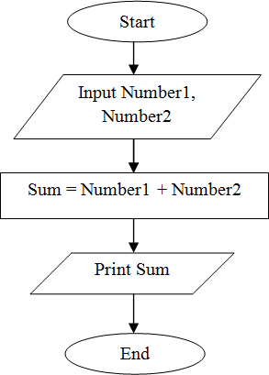
SRM
INSTITUTE OF SCIENCE AND TECHNOLOGY,
CHENNAI.
1. 3 Drawing Flowcharts Contd…

Slide 39
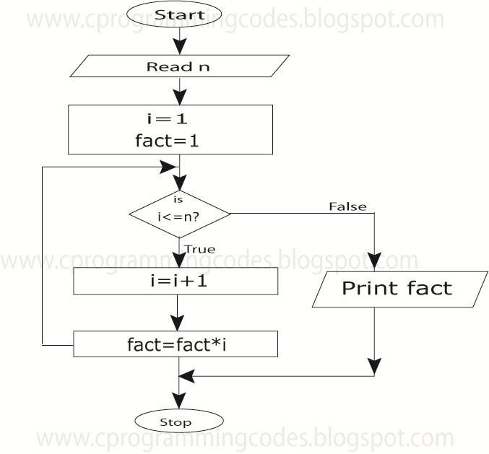

Slide 40
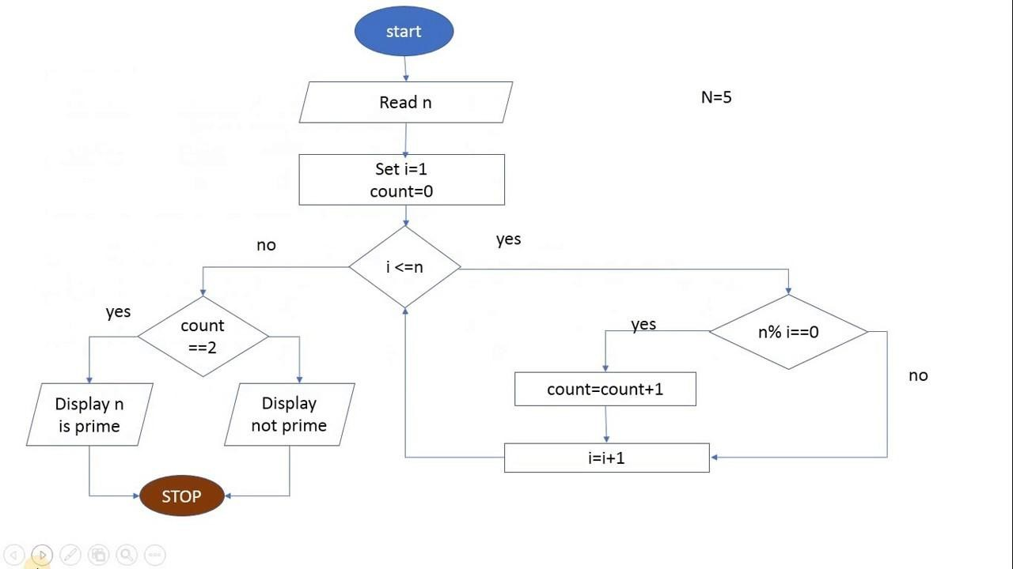

Slide 41
SRM
INSTITUTE OF SCIENCE AND TECHNOLOGY,
CHENNAI.
1. 4 Writing Pseudocode
Pseudo – Imitation / False
Code – Instructions
Goal: To provide a high level description of the Algorithm
Benefit: Enables programmer to concentrate on Algorithm
Similar to programming code
Description of the Algorithm
No specific Programming language notations
Pseudo Code transformed into actual program code

Slide 42
SRM
INSTITUTE OF SCIENCE AND TECHNOLOGY,
CHENNAI.
4 Writing Pseudocode Contd…
Guidelines for Writing Pseudo Code
Write only one Statement per line
Example – Pseudo Code for calculating Salary
READ name, hourly rate, hours worked, deduction rate
Gross pay = hourly rate * hours worked
deduction = gross pay * deduction rate
net pay = gross pay – deduction
WRITE name, gross, deduction, net pay

Slide 43
SRM
INSTITUTE OF SCIENCE AND TECHNOLOGY,
CHENNAI.
4 Writing Pseudocode Contd…
Capitalize Initial Keyword
Keywords to be written in capital letters
Examples: READ, WRITE, IF, ELSE, WHILE, REPEAT, PRINT
Indent to show Hierarchy
Indentation shows the structure boundaries
Sequence
Selection
Looping

Slide 44
SRM
INSTITUTE OF SCIENCE AND TECHNOLOGY,
CHENNAI.
4 Writing Pseudocode Contd…
End Multiline structures
Each structure must end properly
Example: IF statement must end with ENDIF
Keep Statements Language independent
Resist the urge to write Pseudo Code in any programming language

Slide 45
SRM
INSTITUTE OF SCIENCE AND TECHNOLOGY,
CHENNAI.
4 Writing Pseudocode Contd…
Advantages
Easily typed in a Word document
Easily modified
Simple to Use and understand
Implements Structured Concepts
No special symbols are used
No specific syntax is used
Easy to translate into Program

Slide 46
SRM
INSTITUTE OF SCIENCE AND TECHNOLOGY,
CHENNAI.
4 Writing Pseudocode Contd…
Disadvantages
No accepted Standard
Cannot be compiled and executed

Slide 47
SRM
INSTITUTE OF SCIENCE AND TECHNOLOGY,
CHENNAI.
1. 4 Writing Pseudocode Contd…
Write an Pseudo Code to:
Add three numbers and Display the result
Calculate Sum and product of two numbers
Input examination marks and award grades according to the following criteria:
> = 80 Distinction
> = 60 First Class
> = 50 Second Class
< 40 Fail

Slide 48
SRM
INSTITUTE OF SCIENCE AND TECHNOLOGY,
CHENNAI.
4 Writing Pseudocode Contd…
Pseudo Code to Add Three Numbers
Use Variables: sum, num1, num2, num3 of type integer
ACCEPT num1,num2,num3
Sum = num1+num2+num3
Print sum
End Program

Slide 49
SRM
INSTITUTE OF SCIENCE AND TECHNOLOGY,
CHENNAI.
4 Writing Pseudocode Contd…
Calculate Sum and product of two numbers
Use Variables: sum, product, num1, num2 of type real
DISPLAY “Input two Numbers”
ACCEPT num1,num2
Sum = num1+num2
Print “The sum is”, sum
product = num1*num2
Print “The product is”, product
End Program

Slide 50
SRM
INSTITUTE OF SCIENCE AND TECHNOLOGY,
CHENNAI.
4 Writing Pseudocode Contd…
Input examination marks and award grades
Use Variables: mark of type integer
If mark >=80 DISPLAY “Distinction”
If mark >=60 and mark <80 DISPLAY “First Class”
If mark >=50 and mark <60 DISPLAY “Second Class”
If mark <50 DISPLAY “Fail”
End Program

Slide 51

SRM
INSTITUTE OF SCIENCE AND TECHNOLOGY,
CHENNAI.
1. 5 History & Evolution of C
C – General Purpose Programming Language
Developed by Dennis Ritchie in 1972
Developed at Bell Laboratories
Principles taken from BCPL and CPL
Structured Programming Language
C Program
Collection of Functions
Supported by C library

Slide 52
SRM
INSTITUTE OF SCIENCE AND TECHNOLOGY,
CHENNAI.
1. 5 History & Evolution of C Cont…
Father of C Programming : Dennis Ritchie
Born On | September 9 1941
Born in | Bronxville – New York
Full Name | Dennis MacAlistair Ritchie
Nickname | DMR
Nationality | American
Graduate From | Harvard University
Graduate In | Physics and Applied Mathematics
Webpage | http://cm.bell-labs.com/who/dmr/
Dead On | October 12 2011

Slide 53
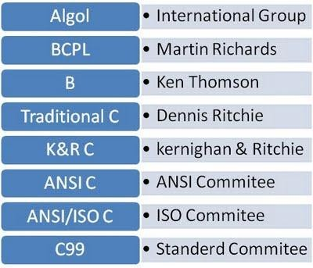
SRM
INSTITUTE OF SCIENCE AND TECHNOLOGY,
CHENNAI.
1. 5 History & Evolution of C Cont…
1960
1967
1970
1972
1978
1989
1990
1999
Evolution of C

Slide 54
SRM
INSTITUTE OF SCIENCE AND TECHNOLOGY,
CHENNAI.
1. 5 History & Evolution of C Cont…
Why the Name “C” was given ?
Many of C’s principles and ideas were derived from the earlier language B
BCPL and CPL are the earlier ancestors of B Language (CPL is
common Programming Language)
In 1967, BCPL Language ( Basic CPL ) was created as a scaled
down version of CPL
As many of the features were derived from “B” Language the new language was named as “C”.

Slide 55
SRM
INSTITUTE OF SCIENCE AND TECHNOLOGY,
CHENNAI.
1. 5 History & Evolution of C Cont…
Characteristics of ‘C’
Low Level Language Support
Structured Programming
Extensive use of Functions
Efficient use of Pointers
Compactness
Program Portability
Loose Typing

Slide 56
SRM
INSTITUTE OF SCIENCE AND TECHNOLOGY,
CHENNAI.
1. 5 History & Evolution of C Cont…
Advantages of C
Compiler based Language
Programming – Easy & Fast
Powerful and Efficient
Portable
Supports Graphics
Supports large number of Operators
Used to Implement Datastructures

Slide 57
SRM
INSTITUTE OF SCIENCE AND TECHNOLOGY,
CHENNAI.
1. 5 History & Evolution of C Cont…
Disadvantages of C
Not a strongly typed Language
Use of Same operator for multiple purposes
Not Object Oriented

Slide 58
SRM
INSTITUTE OF SCIENCE AND TECHNOLOGY,
CHENNAI.
1. 6 Structure of ‘C’ Program
Structure based on Set of rules defined by the Compiler
Sections
Documentation
Preprocessor
Global Declaration
main( ) function
Local Declaration
Program Statements

Slide 59
SRM
INSTITUTE OF SCIENCE AND TECHNOLOGY,
CHENNAI.
1. 6 Structure of ‘C’ Program Contd…
Rules for Writing a C Program
All statements should be written in lower case
All statements should end with a semicolon
Upper case letters are used for symbolic constants
Blank spaces can be inserted between words
No blank space while declaring a variable, keyword, constant
Can write one or more statement in same line separated by
comma
Opening and closing of braces should be balanced

Slide 60
SRM
INSTITUTE OF SCIENCE AND TECHNOLOGY,
CHENNAI.
1. 6 Structure of ‘C’ Program Contd…
/* Program to Find Area of Circle */
Comment
#include <stdio.h> #include <conio.h>
const float pi = 3.14; void main( )
{
float area; int r;
Preprocessor Directives
Global Declaration main Function
Local Declaration & Initialization
printf(“Enter the Radius of the Circle”);
scanf(“%d”, &r);
area = pi * r * r;
printf(“The area of the Circle is %f”, area); getch( );
Execution
}

Slide 61
SRM
INSTITUTE OF SCIENCE AND TECHNOLOGY,
CHENNAI.
1. 6 Structure of ‘C’ Program Contd…
Documentation Section
Used for providing Comments
Comment treated as a single white space by Compiler
Ignored at time of Execution: Not Executable
Comment: Sequence of Characters given between /* and */
Example: Program Name, Statement description
/* Program to Find Area of a Circle*/

Slide 62
SRM
INSTITUTE OF SCIENCE AND TECHNOLOGY,
CHENNAI.
1. 6 Structure of ‘C’ Program Contd…
Preprocessor Section
Also called as Preprocessor Directive
Also called as Header Files
Not a part of Compiler
Separate step in Compilation Process
Instructs Compiler to do required Preprocessing
Begins with # symbol
Preprocessor written within < >

Slide 63
SRM
INSTITUTE OF SCIENCE AND TECHNOLOGY,
CHENNAI.
1. 6 Structure of ‘C’ Program Contd…
Examples
#include <stdio.h>
#include <conio.h>
#include <math.h>
#include <stdlib.h>
#define PI 3.1412

Slide 64
SRM
INSTITUTE OF SCIENCE AND TECHNOLOGY,
CHENNAI.
1. 6 Structure of ‘C’ Program Contd…
Directive | Description
#define | Substitutes a preprocessor macro.
#include | Inserts a particular header from another file.
#undef | Undefines a preprocessor macro.
#ifdef | Returns true if this macro is defined.
#ifndef | Returns true if this macro is not defined.
#if | Tests if a compile time condition is true.
#else | The alternative for #if.
#elif | #else and #if in one statement.
#endif | Ends preprocessor conditional.

Slide 65
SRM
INSTITUTE OF SCIENCE AND TECHNOLOGY,
CHENNAI.
1. 6 Structure of ‘C’ Program Contd…
Directive | Description
#error | Prints error message on stderr.
#pragma | Issues special commands to the compiler, using a standardized method.

Slide 66
SRM
INSTITUTE OF SCIENCE AND TECHNOLOGY,
CHENNAI.
1. 6 Structure of ‘C’ Program Contd…
Global Declaration Section
Used to Declare Global variable (or) Public variable
Variables are declared outside all functions
Variables can be accessed by all functions in the program
Same variable used my more than one function

Slide 67
SRM
INSTITUTE OF SCIENCE AND TECHNOLOGY,
CHENNAI.
1. 6 Structure of ‘C’ Program Contd…
main( ) Section
main( ) written in all small letters (No Capital Letters)
Execution starts with a Opening Brace : {
Divided into two sections: Declaration & Execution
Declaration : Declare Variables
Executable: Statements within the Braces
Execution ends with a Closing Brace : }
Note: main( ) does not end with a semicolon

Slide 68
SRM
INSTITUTE OF SCIENCE AND TECHNOLOGY,
CHENNAI.
1. 6 Structure of ‘C’ Program Contd…
Local Declaration Section
Variables declared within the main( ) program
These variables are called Local Variables
Variables initialized with basic data types

Slide 69
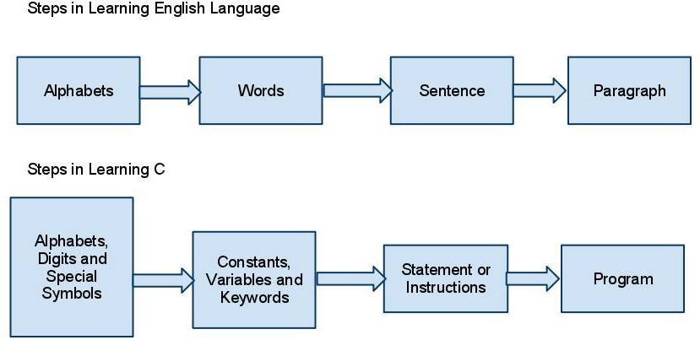
SRM
INSTITUTE OF SCIENCE AND TECHNOLOGY,
CHENNAI.
1. 8 C Programming Fundamentals

Slide 70
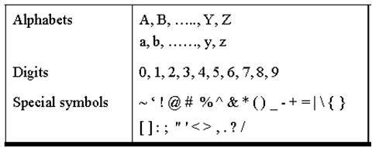
SRM
INSTITUTE OF SCIENCE AND TECHNOLOGY,
CHENNAI.
1. 8 C Programming Fundamentals Contd…

Slide 71
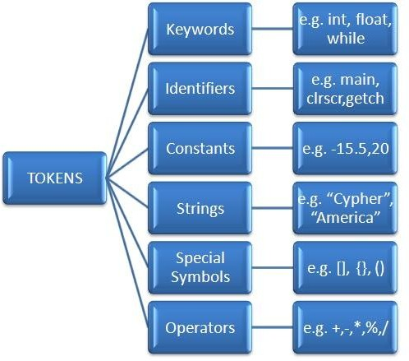
SRM
INSTITUTE OF SCIENCE AND TECHNOLOGY,
CHENNAI.
1. 8 C Programming Fundamentals Contd…
C Token - Smallest individual unit of a C program
C program broken into many C tokens
Building Blocks of C program

Slide 72
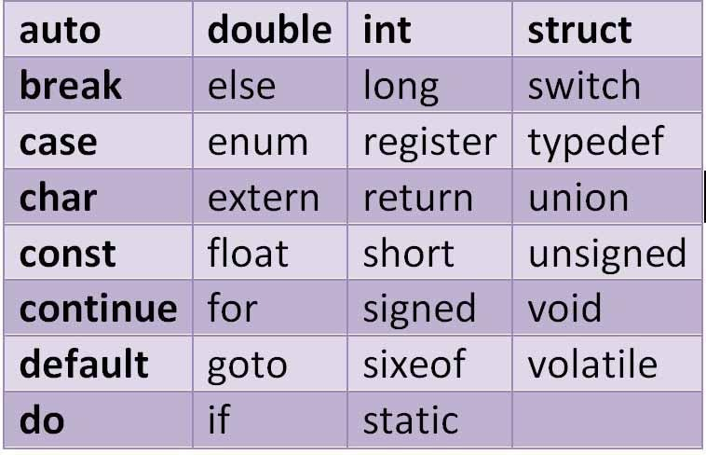
SRM
INSTITUTE OF SCIENCE AND TECHNOLOGY,
CHENNAI.
1. 9 Keywords
Keywords – Conveys special meaning to Compiler
Cannot be used as variable names

Slide 73
SRM
INSTITUTE OF SCIENCE AND TECHNOLOGY,
CHENNAI.
10 Constants
Definition :Value does not change during execution
Can be a Number (or) a Letter
Types
Integer Constants
Real Constants
Character Constant
Single Character Constants
String Constants

Slide 74
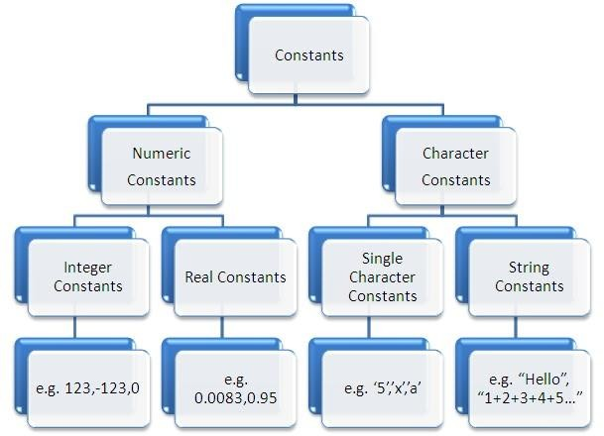
SRM
INSTITUTE OF SCIENCE AND TECHNOLOGY,
CHENNAI.
1. 10 Constants Contd…

Slide 75
SRM
INSTITUTE OF SCIENCE AND TECHNOLOGY,
CHENNAI.
1. 11 Variables & Identifiers
Identifier
A string of alphanumeric characters that begins with an alphabetic character or an underscore character
There are 63 alphanumeric characters, i.e., 53 alphabetic
characters and 10 digits (i.e., 0-9)
Used to represent various programming elements such as
variables, functions, arrays, structures, unions
The underscore character is considered as a letter in identifiers (Usually used in the middle of an identifier)

Slide 76
SRM
INSTITUTE OF SCIENCE AND TECHNOLOGY,
CHENNAI.
11 Variables & Identifiers Contd…
Rules for Identifers
Combination of alphabets, digits (or) underscore
First character should be a Alphabet
No special characters other than underscore can be used
No comma / spaces allowed within variable name
A variable name cannot be a keyword
Variable names are case sensitive
Variable Definition :Value changes during execution
Identifier for a memory location where data is stored

Slide 77
SRM
INSTITUTE OF SCIENCE AND TECHNOLOGY,
CHENNAI.
11 Variables & Identifiers Contd…
Variable name length cannot be more than 31 characters
Examples: AVERAGE, height, a, b, sum, mark_1, gross_pay
Variable Declaration
A variable must be declared before it is used
Declaration consists of a data type followed by one or
more variable names separated by commas.
Syntax
datatype variablename;

Slide 78
SRM
INSTITUTE OF SCIENCE AND TECHNOLOGY,
CHENNAI.
11 Variables & Identifiers Contd…
Examples
int a, b, c, sum; float avg;
char name;
Variable Initialization
Assigning a value to the declared variable
Values assigned during declaration / after declaration

Slide 79
SRM
INSTITUTE OF SCIENCE AND TECHNOLOGY,
CHENNAI.
11 Variables & Identifiers Contd…
Examples
int a, b, c;
a=10, b=20, c=30;
ii. int a=10 ,b=10, c=10;
Scope of Variables
Local Variables
Global Variables

Slide 80
SRM
INSTITUTE OF SCIENCE AND TECHNOLOGY,
CHENNAI.
1. 12 Scope of Variables
Definition
A scope in any programming is a region of the program where a defined variable can have its existence and beyond that variable it cannot be accessed
Variable Scope is a region in a program where a variable is declared and used
The scope of a variable is the range of program statements that
can access that variable
A variable is visible within its scope and invisible outside it

Slide 81
SRM
INSTITUTE OF SCIENCE AND TECHNOLOGY,
CHENNAI.
1. 12 Scope of Variables Contd…
There are three places where variables can be declared
Inside a function or a block which is called local variables
Outside of all functions which is called global variables
c)
In the definition of function parameters which are
called formal parameters

Slide 82
SRM
INSTITUTE OF SCIENCE AND TECHNOLOGY,
CHENNAI.
1. 12 Scope of Variables Contd…
Local Variables
Variables that are declared inside a function or block are called local variables
They can be used only by statements that are inside that
function or block of code
Local variables are created when the control reaches the block or function containing the local variables and then they get destroyed after that
Local variables are not known to functions outside their own

Slide 83
/* Program for Demonstrating Local Variables*/
#include <stdio.h>
int main ( )
{
/* local variable declaration */
int a, b; int c;
/* actual initialization */
a = 10; b = 20;
c = a + b;
printf ("value of a = %d, b = %d and c = %d\n", a, b, c);
return 0;
}

Slide 84
SRM
INSTITUTE OF SCIENCE AND TECHNOLOGY,
CHENNAI.
1. 12 Scope of Variables Contd…
Global Variables
Defined outside a function, usually on top of the program
Hold their values throughout the lifetime of the program
Can be accessed inside any of the functions defined for the
program
Can be accessed by any function
That is, a global variable is available for use throughout
the entire program after its declaration

Slide 85
/* Program for Demonstrating Global Variables*/
#include <stdio.h>
/* global variable declaration */
int g;
int main ( )
{
/* local variable declaration */
int a, b;
/* actual initialization */
a = 10; b = 20;
g = a + b;
printf ("value of a = %d, b = %d and g = %d\n", a, b, g);
return 0;
}

Slide 86
SRM
INSTITUTE OF SCIENCE AND TECHNOLOGY,
CHENNAI.
1. 12 Scope of Variables Contd…
Note: A program can have same name for local and global variables but the value of local variable inside a function will take preference

Slide 87
SRM
INSTITUTE OF SCIENCE AND TECHNOLOGY,
CHENNAI.
12 Datatypes
Defines a variable before use
Specifies the type of data to be stored in variables
Basic Data Types – 4 Classes
int – Signed or unsigned number
float – Signed or unsigned number having Decimal Point
double – Double Precision Floating point number
char – A Character in the character Set
Qualifiers

Slide 88
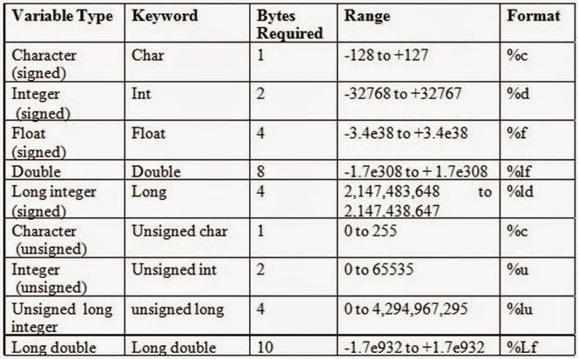
SRM
INSTITUTE OF SCIENCE AND TECHNOLOGY,
CHENNAI.
1. 12 Datatypes Contd…

Slide 89
SRM
INSTITUTE OF SCIENCE AND TECHNOLOGY,
CHENNAI.
12 Datatypes Contd…
Integer Data Type
Whole numbers with a range
No fractional parts
Integer variable holds integer values only
Keyword: int
Memory: 2 Bytes (16 bits) or 4 Bytes (32 bits)
Qualifiers: Signed, unsigned, short, long
Examples: 34012, 0, -2457

Slide 90
SRM
INSTITUTE OF SCIENCE AND TECHNOLOGY,
CHENNAI.
12 Datatypes Contd…
Floating Point Data Type
Numbers having Fractional part
Float provides precision of 6 digits
Integer variable holds integer values only
Keyword: float
Memory: 4 Bytes (32 bits)
Examples: 5.6, 0.375, 3.14756

Slide 91
SRM
INSTITUTE OF SCIENCE AND TECHNOLOGY,
CHENNAI.
12 Datatypes Contd…
Double Data Type
Also handles floating point numbers
Double provides precision of 14 digits
Integer variable holds integer values only
Keyword: float
Memory: 8 Bytes (64 bits) or 10 Bytes (80 bits)
Qualifiers: long, short

Slide 92
SRM
INSTITUTE OF SCIENCE AND TECHNOLOGY,
CHENNAI.
12 Datatypes Contd…
Character Data Type
handles one character at a time
Keyword: char
Memory: 1 Byte (8 bits)

Slide 93
SRM
INSTITUTE OF SCIENCE AND TECHNOLOGY,
CHENNAI.
1. 13 Expressions
Expression : An Expression is a collection of operators and
operands that represents a specific value
Operator : A symbol which performs tasks like arithmetic
operations, logical operations and conditional operations
Operands : The values on which the operators perform the task
Expression Types in C
Infix Expression
Postfix Expression
Prefix Expression

Slide 94
SRM
INSTITUTE OF SCIENCE AND TECHNOLOGY,
CHENNAI.
1. 13 Expressions Contd…
Infix Expression
The operator is used between operands
General Structure : Operand1 Operator Operand2
Example : a + b
Postfix Expression
Operator is used after operands
General Structure : Operand1 Operand2 Operator
Example : ab+

Slide 95
SRM
INSTITUTE OF SCIENCE AND TECHNOLOGY,
CHENNAI.
1. 13 Expressions Contd…
Prefix Expression
Operator is used before operands
General Structure : Operator Operand1 Operand2
Example : +ab

Slide 96
SRM
INSTITUTE OF SCIENCE AND TECHNOLOGY,
CHENNAI.
14 Input and Output Functions
Ability to Communicate with Users during execution
Input Operation
Feeding data into program
Data Transfer from Input device to Memory
Output Operation
Getting result from Program
Data Transfer from Memory to Output device
Header File : #include<stdio.h>

Slide 97
SRM
INSTITUTE OF SCIENCE AND TECHNOLOGY,
CHENNAI.
14 Input and Output Functions Contd…
Input / Output Function Types
Formatted Input / Output Statements
Unformatted Input / Output Statements

Slide 98
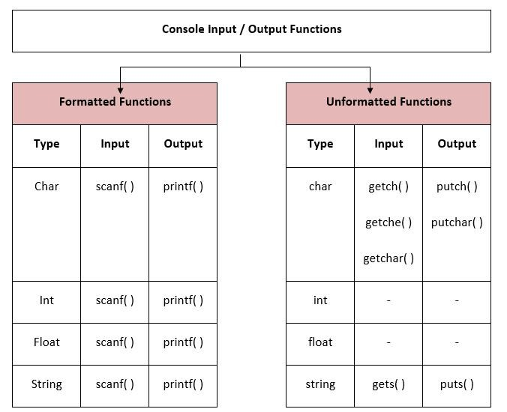

Slide 99
SRM
INSTITUTE OF SCIENCE AND TECHNOLOGY,
CHENNAI.
14 Input and Output Functions Contd…
Formatted Input / Output Statements
Reads and writes all types of data values
Arranges data in particular format
Requires Format Specifier to identify Data type
Basic Format Specifiers
%d – Integer
%f – Float
%c – Character
%s - String

Slide 100
SRM
INSTITUTE OF SCIENCE AND TECHNOLOGY,
CHENNAI.
14 Input and Output Functions Contd…
The scanf ( ) Function
Reads all types of input data
Assignment of value to variable during Runtime
Syntax
scanf(“Control String/Format Specifier”, &arg1, &arg2,… &argn)
Control String / Format Specifier
arg1, arg2.,,, arg n – Arguments (Variables)
& - Address

Slide 101
SRM
INSTITUTE OF SCIENCE AND TECHNOLOGY,
CHENNAI.
1. 14 Input and Output Functions Contd…
/* Giving Direct Input in
Program */
/*Getting Input using scanf ( ) function */
#include<stdio.h> #include<conio.h> void main( )
{
int a; a=10;
}
#include<stdio.h> #include<conio.h> void main( )
{
int a;
scanf(“%d”, &a);
}

Slide 102
SRM
INSTITUTE OF SCIENCE AND TECHNOLOGY,
CHENNAI.
1. 14 Input and Output Functions Contd…
/* Getting Multiple Input using scanf ( ) function */
#include<stdio.h> #include<conio.h> void main( )
{
int a, b, c;
scanf(“%d%d%d”,&a,&b,&c);
}
/* Getting Multiple Different Inputs
using scanf ( ) function */
#include<stdio.h> #include<conio.h> void main( )
{
int a, b; float c;
scanf(“%d%d%f”,&a,&b,&c);
}

Slide 103
SRM
INSTITUTE OF SCIENCE AND TECHNOLOGY,
CHENNAI.
1. 14 Input and Output Functions Contd…
/* Getting Multiple Input using scanf ( ) function */
#include<stdio.h> #include<conio.h> void main( )
{
int a, b; float c;
scanf(“%d %d”, &a, &b);
scanf(“%f ”, &c);
}

Slide 104
SRM
INSTITUTE OF SCIENCE AND TECHNOLOGY,
CHENNAI.
14 Input and Output Functions Contd…
The printf ( ) Function
To print Instructions / Output onto the Screen
Requires Format Specifiers & Variable names to print
data
Syntax
printf(“Control String/Format Specifier”,arg1,arg2,… argn)
Control String / Format Specifier
arg1, arg2.,,, arg n – Arguments (Variables)

Slide 105
SRM
INSTITUTE OF SCIENCE AND TECHNOLOGY,
CHENNAI.
1. 14 Input and Output Functions Contd…
/* Example 1 – Using printf ( ) & scanf ( ) function */
#include<stdio.h> #include<conio.h> void main( )
{
int a;
printf(“Enter the Value of a”); scanf(“%d”, &a);
printf(“Value of a is %d”, a); getch( );
}

Slide 106
SRM
INSTITUTE OF SCIENCE AND TECHNOLOGY,
CHENNAI.
1. 14 Input and Output Functions Contd…
/* Example 2 – Using printf ( ) & scanf ( ) function */
#include<stdio.h> #include<conio.h> void main( )
{
int a, b, c;
printf(“Enter the Value of a, b & c”); scanf(“%d %d %d”, &a, &b, &c);
printf(“Value of a, b & c is %d%d%d”, a, b, c); getch ( );
}

Slide 107
/* Example 3 – Using printf ( ) & scanf ( ) function */ #include<stdio.h>
#include<conio.h> void main( )
{
int a, b; float c;
printf(“Enter the Value of a & b”); scanf(“%d %d”, &a, &b);
printf(“Enter the Value of a & b”);
scanf(“%f ”, &c);
printf(“Value of a, b is %d%d”, a, b); printf(“Value of c is %f”, c);
getch ( );
}

Slide 108
SRM
INSTITUTE OF SCIENCE AND TECHNOLOGY,
CHENNAI.
1. 14 Input and Output Functions Contd…
/* Example 4 – Using printf ( ) & scanf ( ) function */
#include<stdio.h> #include<conio.h> void main( )
{
int a, b; float c;
printf(“Enter the Value of a, b & c”);
scanf(“%d %d%f”, &a, &b, &c);
printf(“Value of a, b & c is %d%d%f”, a, b, c); getch ( );
}

Slide 109
SRM
INSTITUTE OF SCIENCE AND TECHNOLOGY,
CHENNAI.
14 Input and Output Functions Contd…
Try it Out Yourself ! Write a C program to:
Add two numbers
To Multiply two floating point numbers
To compute Quotient and Remainder
To Swap two numbers

Slide 110
SRM
INSTITUTE OF SCIENCE AND TECHNOLOGY,
CHENNAI.
1. 14 Input and Output Functions Contd…
Unformatted Input / Output Statements
Works only with Character Data type
No need of Format Specifier
Unformatted Input Statements
getch ( ) – Reads alphanumeric characters
from
Keyboard
ii. getchar ( ) – Reads one character at a time till enter key
is pressed

Slide 111
SRM
INSTITUTE OF SCIENCE AND TECHNOLOGY,
CHENNAI.
1. 14 Input and Output Functions Contd…
iii. gets ( ) – Accepts any string from Keyboard until Enter Key
is pressed
Unformatted Output Statements
putch ( ) – Writes alphanumeric characters to Monitor
(Output Device)
putchar ( ) – Prints one character at a time
puts ( ) – Prints a String to Monitor (Output Device)

Slide 112
SRM
INSTITUTE OF SCIENCE AND TECHNOLOGY,
CHENNAI.
1. 16 Single Line and Multiline Comments
Comment – Definition
Used to provide information about lines of code
Provide clarity to the C source code
Allows others to better understand what the code was
intended to
Helps in debugging the code
Important in large projects containing
thousands of lines of source code
Types – Single line and multiline comment
hundreds or

Slide 113
SRM
INSTITUTE OF SCIENCE AND TECHNOLOGY,
CHENNAI.
1. 16 Single Line and Multiline Comments Contd…
Single Line Comment
Represented by double slash \\
#include<stdio.h>
int main( ){
//printing information printf("Hello C");
return 0;
}

Slide 114
SRM
INSTITUTE OF SCIENCE AND TECHNOLOGY,
CHENNAI.
1. 16 Single Line and Multiline Comments Contd…
Multi-Line Comment
Represented by slash asterisk \* ... *\
#include<stdio.h>
int main( ){
/*printing information
Multi Line Comment*/ printf("Hello C");
return 0;
}

Slide 115
SRM
INSTITUTE OF SCIENCE AND TECHNOLOGY,
CHENNAI.
1. 16 Single Line and Multiline Comments Contd…
Single-Line Comments | Multi-Line Comment
Starts with /* and ends with */ | Starts with //
All Words and Statements written between /* and */ are ignored | Statements after the symbol // upto the end of line are ignored
Comment ends when */ Occures | Comment Ends whenever ENTER is Pressed and New Line Starts
e.g /* Program for Factorial */ | e.g // Program for Fibonacci

Slide 116
SRM
INSTITUTE OF SCIENCE AND TECHNOLOGY,
CHENNAI.
15 Operators in C
C supports rich set of built in Operators
Used to manipulate Constants (Data) & Variables
Part of Mathematical (or) Logical expressions
Operators vs Operands
Operator – Definition
Symbol (or) Special character that instructs the compiler
to perform mathematical (or) Logical operations

Slide 117
SRM
INSTITUTE OF SCIENCE AND TECHNOLOGY,
CHENNAI.
15 Operators in C Contd…
Classification of Operators
Increment & Decrement Operators
Comma Operator
Arrow Operator
Assignment Operators
Bitwise Operators
Sizeof Operator

Slide 118
SRM
INSTITUTE OF SCIENCE AND TECHNOLOGY,
CHENNAI.
1. 15 Operators in C Contd…
Increment and Decrement Operators
Increment and decrement operators are unary operators that add or subtract one from their operand
C languages feature two versions (pre- and post-) of each
operator
Operator placed before variable (Pre)
Operator placed before variable (Post)
The increment operator is written as ++ and the decrement
operator is written as --

Slide 119
SRM
INSTITUTE OF SCIENCE AND TECHNOLOGY,
CHENNAI.
1. 15 Operators in C Contd…
Increment and Decrement Operators Contd…
Classification
Pre Increment Operator
Post Increment Operator
Pre Decrement Operator
Post Decrement Operator

Slide 120
SRM
INSTITUTE OF SCIENCE AND TECHNOLOGY,
CHENNAI.
1. 15 Operators in C Contd…
Increment and Decrement Operators Contd…
Syntax
(pre)++variable_name; (pre)- -variable_name;
(Or)
variable_name++ (post); variable_name – (Post);
Examples
❑ ++count, ++a, ++i, ++count
Count++, a++, i++, count++

Slide 121
SRM
INSTITUTE OF SCIENCE AND TECHNOLOGY,
CHENNAI.
1. 15 Operators in C Contd…
a) Increment and Decrement Operators Contd…
S. No | Operator type | Operator | Description
1 | Pre Increment | ++i | Value of i is incremented before assigning it to variable i.
2 | Post Increment | i++ | Value of i is incremented after assigning it to variable i.
3 | Pre Decrement | -- i | Value of i is decremented before assigning it to variable i.
4 | Post Decrement | i -- | Value of i is decremented after assigning it to variable i.

Slide 122
/* Program for Post Increment*/
#include<stdio.h> #include<conio.h> void main( )
{
int i = 1;
while (i++<5)
{
printf(“%d”, i);
}
getch ( );
}
}
Output
1 2 3 4 5

Slide 123
SRM
INSTITUTE OF SCIENCE AND TECHNOLOGY,
CHENNAI.
1. 15 Operators in C Contd…
a) Increment and Decrement Operators Contd…
Step 1 : In this program, value of i “0” is compared with 5 in while expression.
Step 2 : Then, value of “i” is incremented from 0 to 1 using post-
increment operator.
Step 3 : Then, this incremented value “1” is assigned to the
variable “i”.
Above 3 steps are continued until while expression becomes false and output is displayed as “1 2 3 4 5”.

Slide 124
/* Program for Pre Increment*/
#include<stdio.h> #include<conio.h> void main( )
{
int i = 1;
while (++i<5)
{
printf(“%d”, i );
}
getch ( );
}
}
Output
1 2 3 4

Slide 125
SRM
INSTITUTE OF SCIENCE AND TECHNOLOGY,
CHENNAI.
1. 15 Operators in C Contd…
a) Increment and Decrement Operators Contd…
Step 1 : In above program, value of “i” is incremented from 0 to 1 using pre-increment operator.
Step 2 : This incremented value “1” is compared with 5 in while
expression.
Step 3 : Then, this incremented value “1” is assigned to the
variable “i”.
Above 3 steps are continued until while expression becomes false and output is displayed as “1 2 3 4”.

Slide 126
/* Program for Post Decrement*/
#include<stdio.h> #include<conio.h> void main( )
{
int i = 1;
while (i--<5)
{
printf(“%d”, i );
}
getch ( );
}
}
Output
9 8 7 6 5

Slide 127
SRM
INSTITUTE OF SCIENCE AND TECHNOLOGY,
CHENNAI.
1. 15 Operators in C Contd…
a) Increment and Decrement Operators Contd…
Step 1 : In this program, value of i “10” is compared with 5 in while expression.
Step 2 : Then, value of “i” is decremented from 10 to 9 using post-
decrement operator.
Step 3 : Then, this decremented value “9” is assigned to the
variable “i”.
Above 3 steps are continued until while expression becomes false and output is displayed as “9 8 7 6 5”.

Slide 128
/* Program for Pre Decrement*/
#include<stdio.h> #include<conio.h> void main( )
{
int i = 1;
while (--i<5)
{
printf(“%d”, i);
}
getch ( );
}
}
Output
9 8 7 6

Slide 129
SRM
INSTITUTE OF SCIENCE AND TECHNOLOGY,
CHENNAI.
1. 15 Operators in C Contd…
a) Increment and Decrement Operators Contd…
Step 1 : In above program, value of “i” is decremented from 10 to 9 using pre-decrement operator.
Step 2 : This decremented value “9” is compared with 5 in while
expression.
Step 3 : Then, this decremented value “9” is assigned to the
variable “i”.
Above 3 steps are continued until while expression becomes false and output is displayed as “9 8 7 6”.

Slide 130
SRM
INSTITUTE OF SCIENCE AND TECHNOLOGY,
CHENNAI.
1. 15 Operators in C Contd…
Comma Operator
Special operator which separates the declaration of multiple variables
Has Lowest Precedence i.e it is having lowest priority so it is
evaluated at last
Returns the value of the rightmost operand when multiple
comma operators are used inside an expression
Acts as Operator in an Expression and as a Separator while Declaring Variables

Slide 131
SRM
INSTITUTE OF SCIENCE AND TECHNOLOGY,
CHENNAI.
1. 15 Operators in C Contd…
b) Comma Operator Contd…
#include<stdio.h>
int main( )
{
int i, j; i=(j=10, j+20);
printf(“i = %d\n j = %d\n” , i,j );
return 0;
}

Slide 132
SRM
INSTITUTE OF SCIENCE AND TECHNOLOGY,
CHENNAI.
1. 15 Operators in C Contd…
Arrow Operator (->)
Arrow operator is used to access the structure members when we use pointer variable to access it
When pointer to a structure is used then arrow operator is
used

Slide 133
SRM
INSTITUTE OF SCIENCE AND TECHNOLOGY,
CHENNAI.
1. 15 Operators in C Contd…
Assignment Operators
Assigns result of expression to a variable
Performs Arithmetic and Assignment operations
Commonly used Assignment operator: =
Syntax
variable = expression;
Examples
num = 25; age = 18; pi = 31.4; area = 3.14 * r * r;

Slide 134
SRM
INSTITUTE OF SCIENCE AND TECHNOLOGY,
CHENNAI.
1. 15 Operators in C Contd…
Shorthand Assignment Operators
Simple Assignment Operator | Shorthand Operator
a = a + 1 | a+=1
a = a – 1 | a-=1
a = a * 2 | a*=2
a = a / b | a/=b
a = a % b | a%=b
c = c * (a + b) | c *= (a + b)
b = b / (a + b) | b /=(a + b)

Slide 135
/* Program for Assignment Operations*/
#include<stdio.h> #include<conio.h> void main( )
{
int a;
a = 11;
a+ = 4;
printf(“Value of A is %d\n”,a); a = 11;
a- = 4;
printf(“Value of A is %d\n”,a); a = 11;
a* = 4;
printf(“Value of A is %d\n”,a); a = 11; a/ = 4;

Slide 136
printf(“Value of A is %d\n”,a);
a = 11;
a% = 4;
printf(“Value of A is %d\n”,a); getch ( );
}
Output
Value of A is 15 Value of A is 7
Value of A is 44 Value of A is 2
Value of A is 3

Slide 137
THANK YOU

